Slide 1


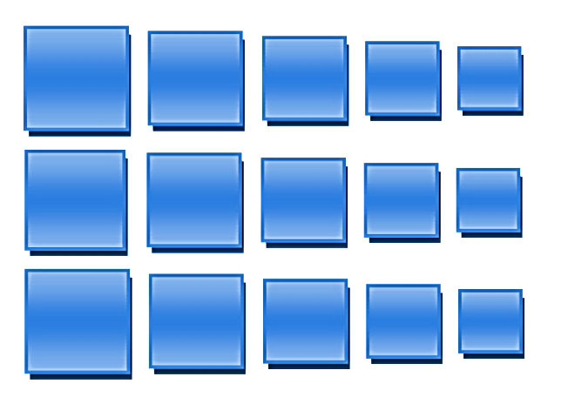
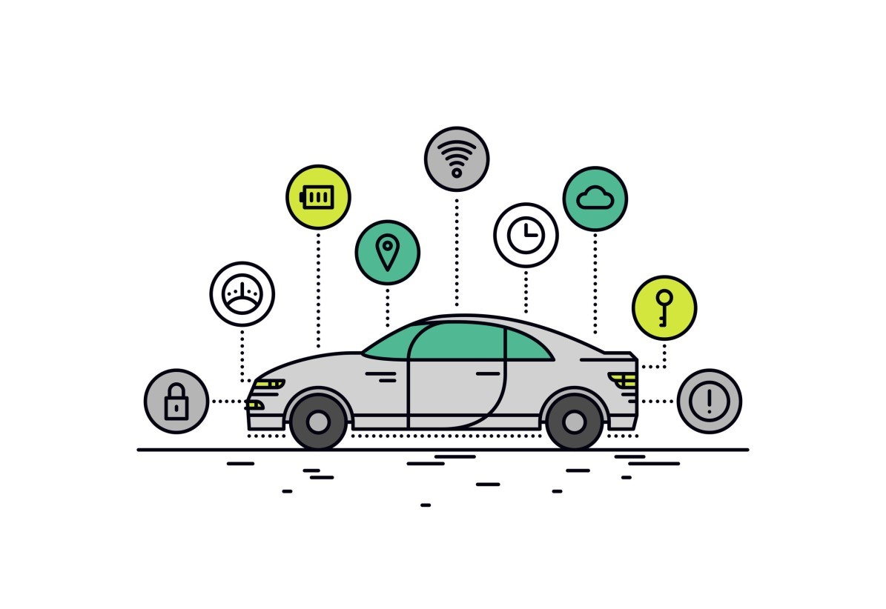
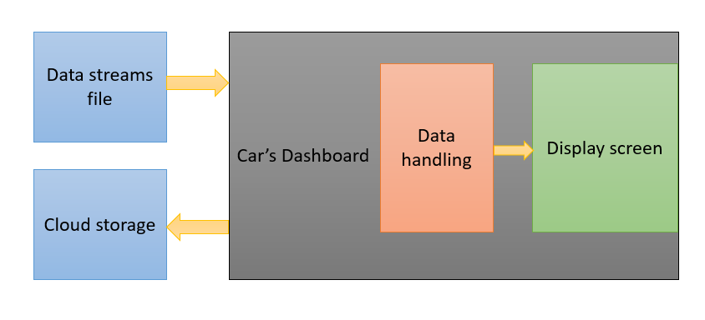
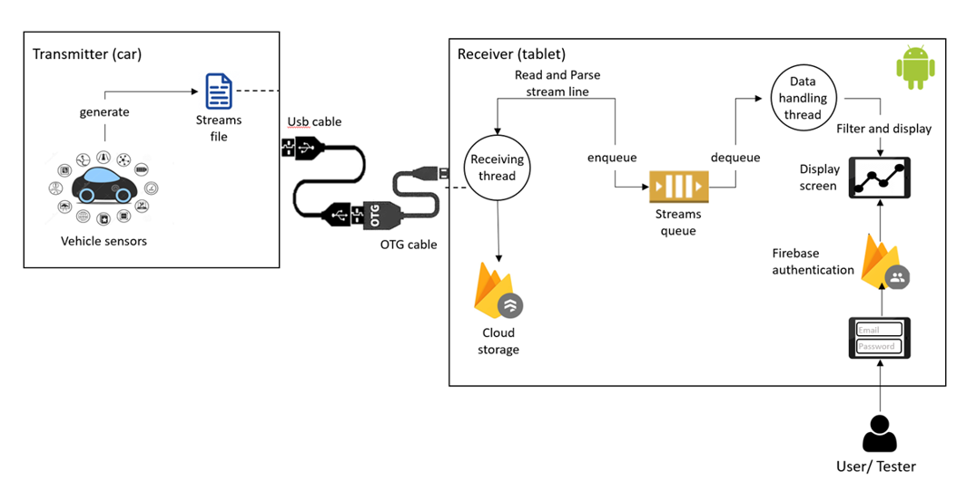
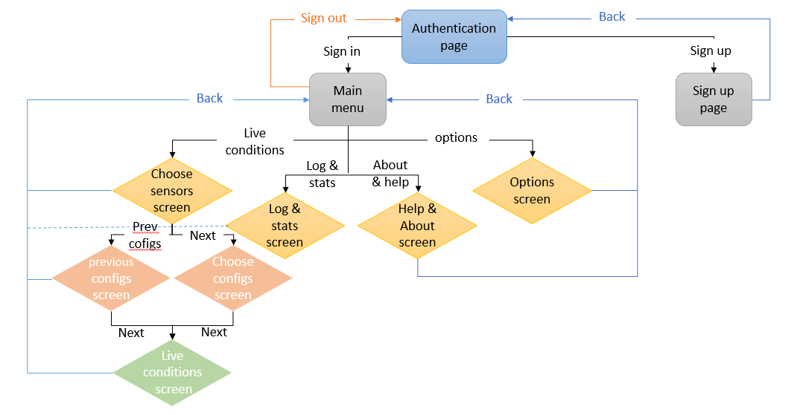
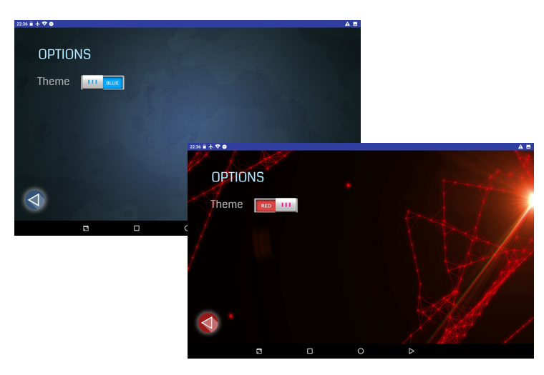
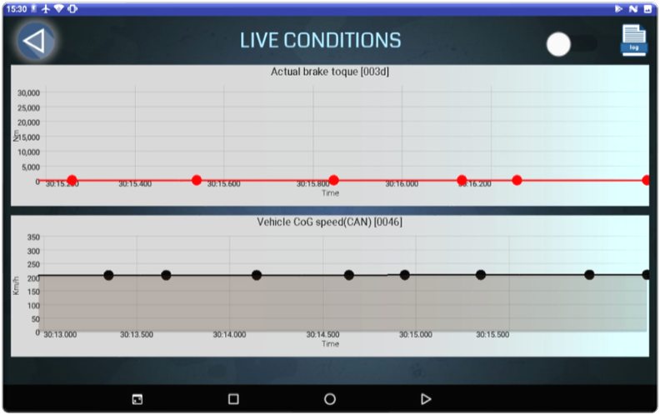
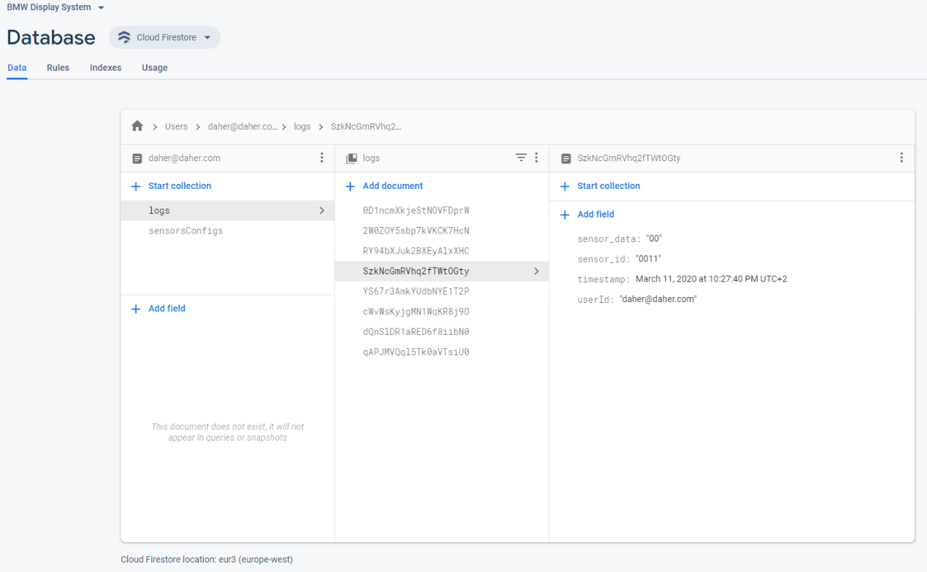
The Andrew & Erna Viterbi Faculty of
Electrical Engineering
Electronics
Computers
Communications
Infrastructure for cars display unit
Daher Daher & Vivian Lawin | Supervised by: Boaz mizrachi
Background: Cars testing
Project Goals and Challenges
In order to enhance and improve the driving experience in cars in general (and autonomous cars in particular), drivers and car testers must understand and feel not only the condition of the environment, but also the condition of the road.
The more the testing procedure is efficient the more the results are reliable, and time is saved. both advantages are highly desired in the era of new technology, and especially in the emerging field of Artificial Intelligence and autonomous cars, enabling a transformation and technological rise in the mobility industry.
Easy-to-use application.
receives sensors data collected by the vehicle, directly from the vehicle without any middle-man.
Cloud storage of test results.
User authentication to support secure logging and data recording.
Support multiple graphs (Up to 3 graphs at a time).
Offers different configurations (Resolution, Max value, Color…).
Time axis scaling.
Previous configurations feature: allowing testers to choose one of previously chosen sensors and configurations.
Different appearance theme.
High Level Design
User Interface
Designed to be as user-friendly and simple as possible, while protecting each user’s privacy.
Back-end: Receiver, Authentication and Cloud storage
Results
Receiver connected to transmitter via USB + OTG cable.
Pipeline
Receive → Parse → Enqueue → Dequeue → Process
In addition to filtering data, receiver also reads
and parses data from data streams file .
supports authentication using Emails and passwords.
NoSQL database
Documents and Collections hierarchy
Realtime Database.
Easy-to-use application.
Real-time car sensors data graphs, displayed as user’s preferences.
Access to previously logged data.

